Slide 1




Slide 2
Agenda
Introduction
Problem Statement
Data
Methodology
Results

Slide 3
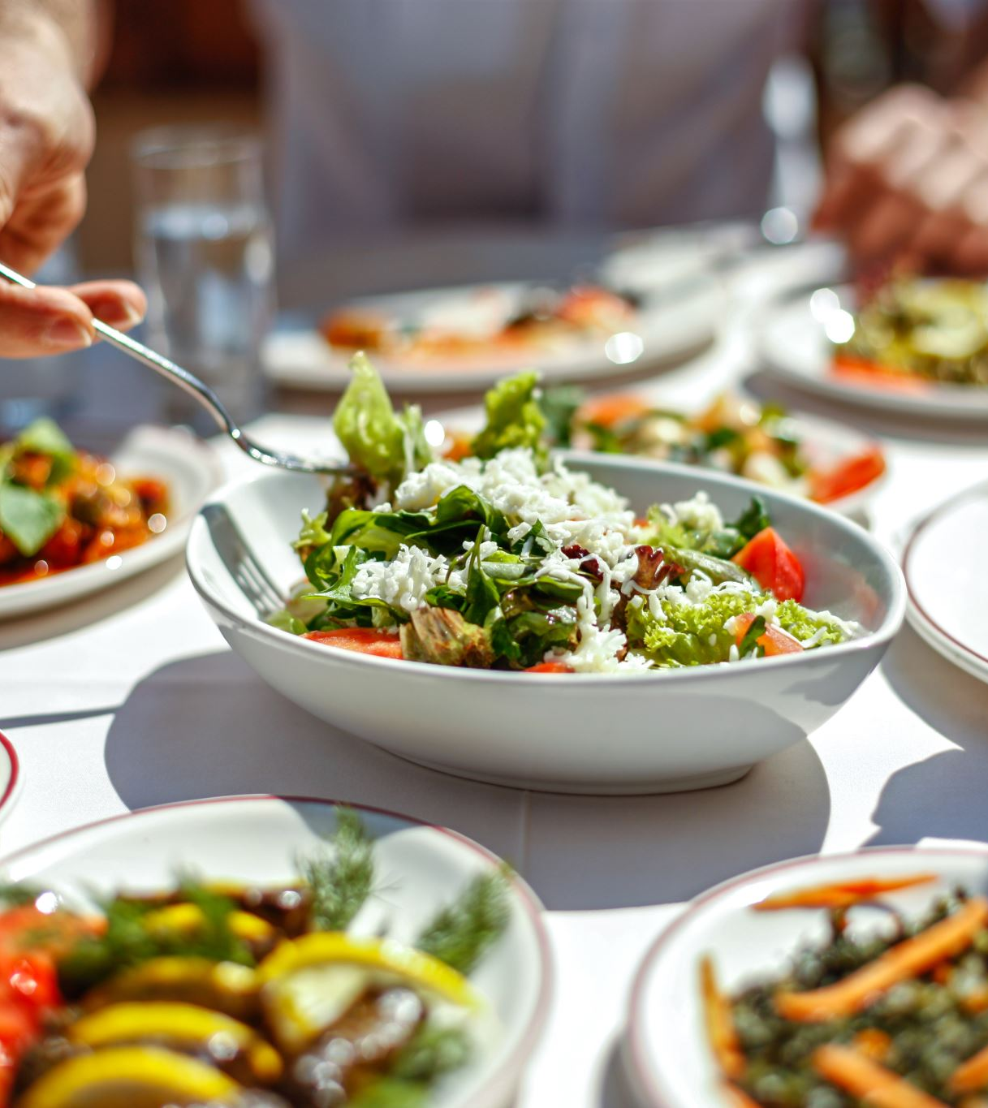
introduction
Bengaluru being one such city has more than 12,000 restaurants with restaurants serving dishes from all over the world

Slide 4
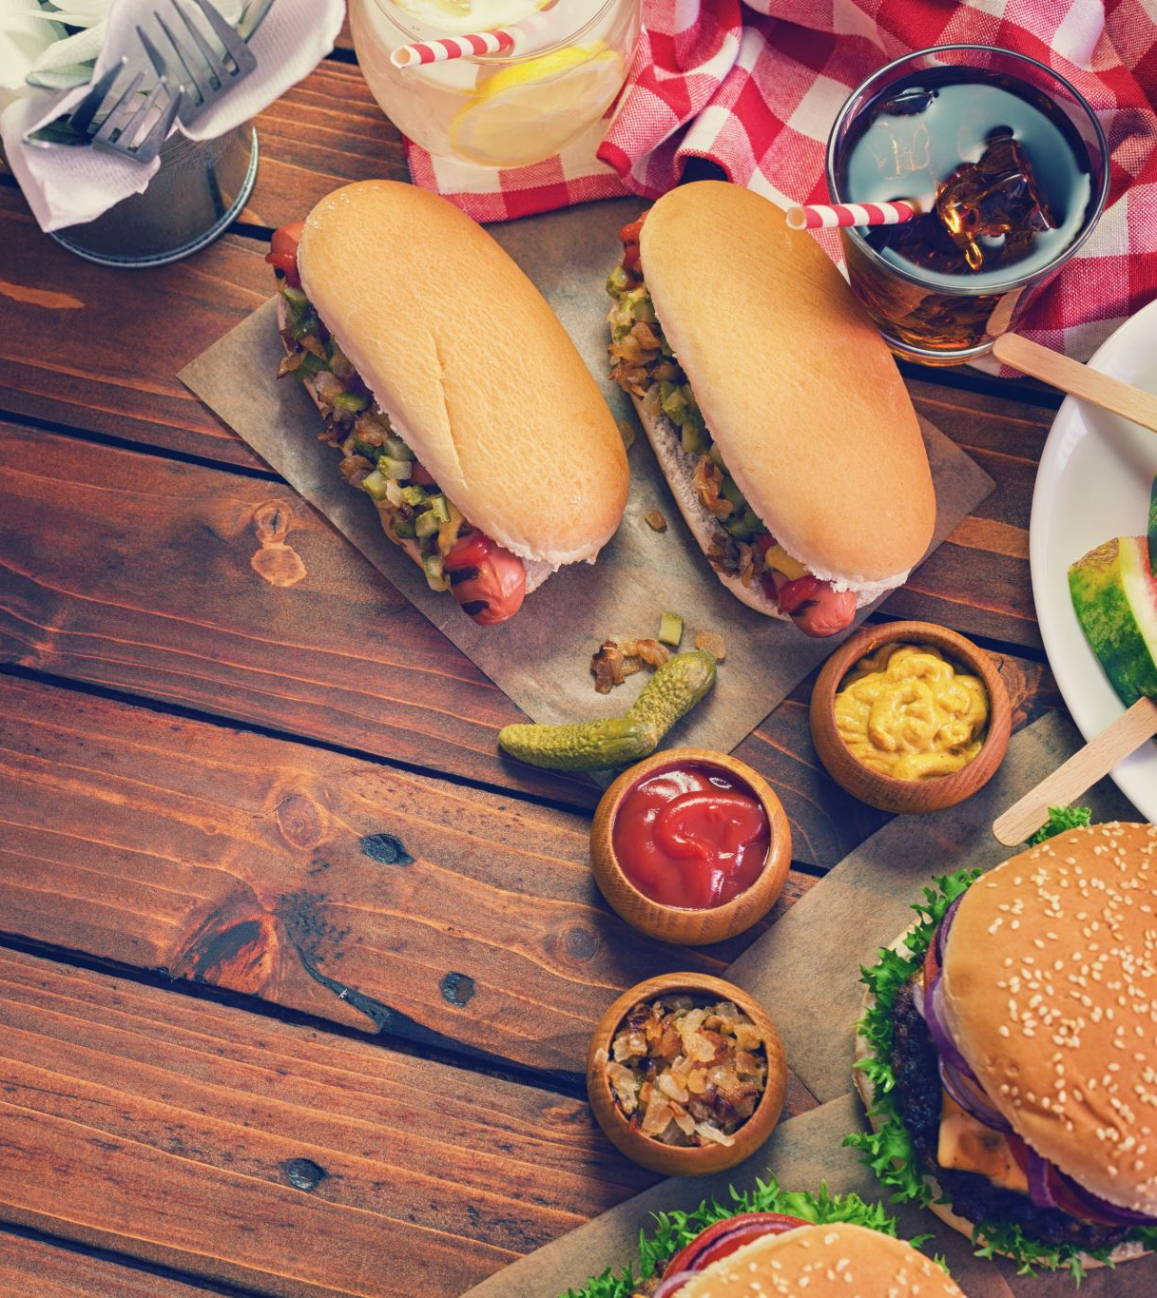
Problem Statement
We can’t rate the new restaurants so if we know some things, we can rate them
We want to know the rating of new restaurant based on its votes and the cost or approximate cost If 2 people will buy a meal

Slide 5

Data
Actually data was for EDA but we make some preprocessing to use it in our purpose

Slide 6
Methodology
par plot to showthe most repeated restaurant in the data
Also used correlation table to see the correlation between features
lastly show the percentage of restaurants that provide book table and online order with its rate

Slide 7
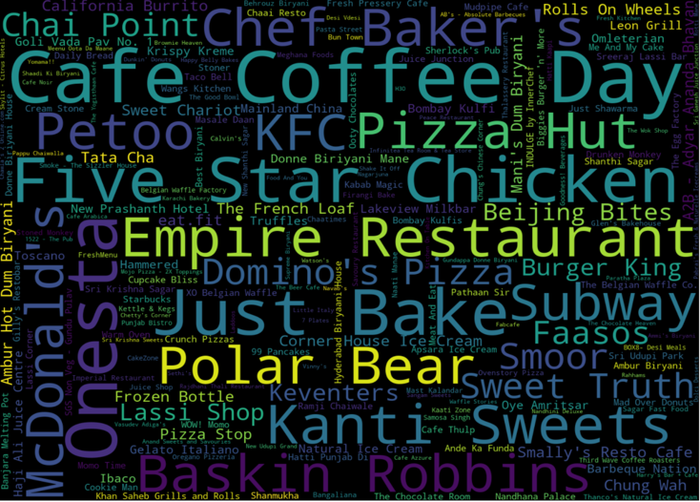
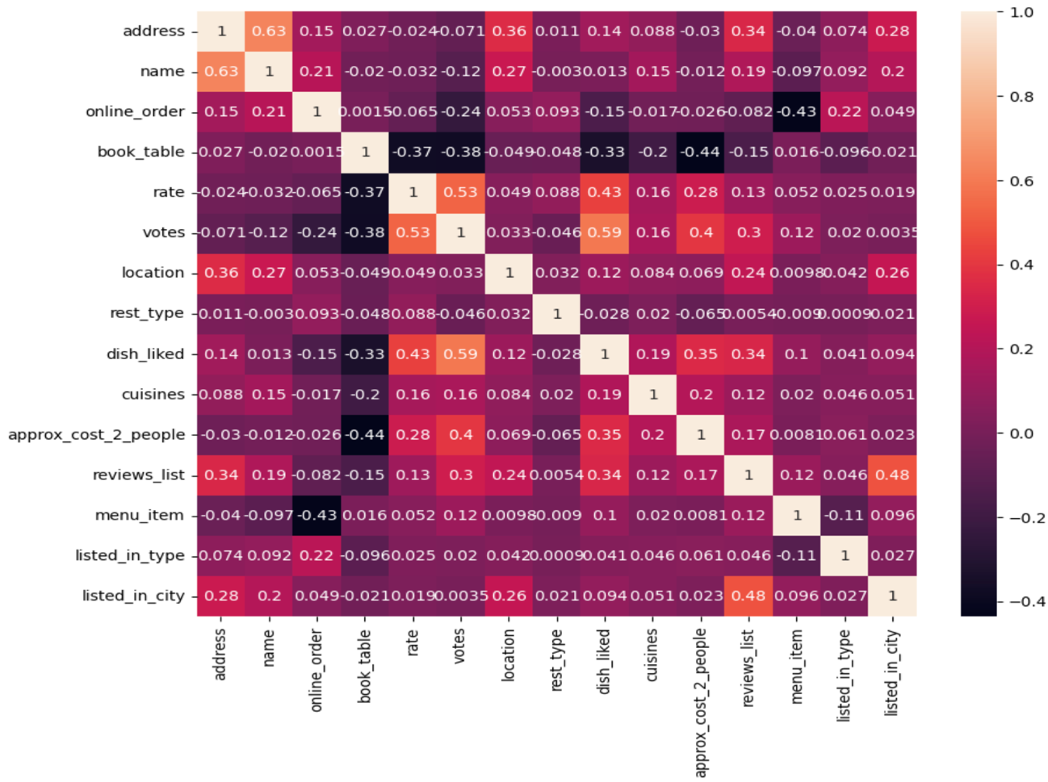
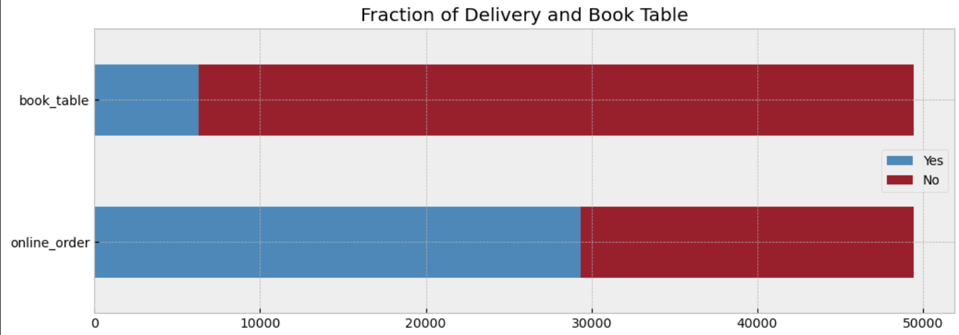

Slide 8
Results
The restaurants that have rate more than 3.7 is higher than the restaurants that have rate Less than 3.7
The accuracy of our model is 86%

